Slide 1
ALA Online Communities
A new way to meet, discuss and share information

Slide 2
ALA Online Communities Background
Based on Member requests to “facilitate committee and other work between conferences and meetings”
RFP written and vetted by member and staff committees
Selected vendor: NetOn-Line
Development to begin in January 2005
Beta-testing by staff and members in spring 2005

Slide 3
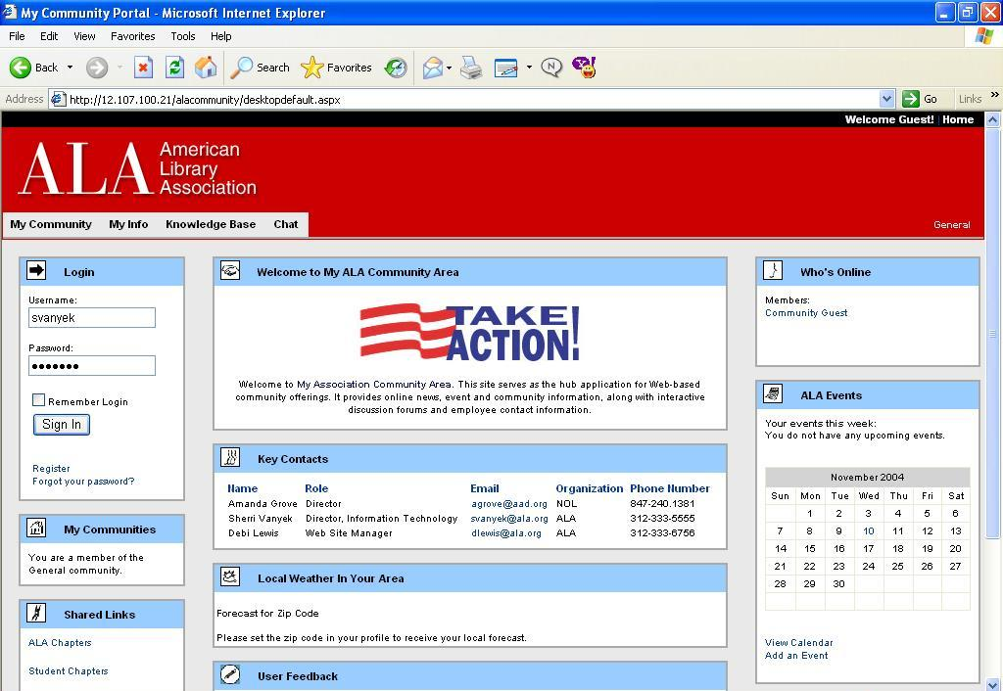
Main Login Page
Members enter their Username and Password to sign in.

Slide 4
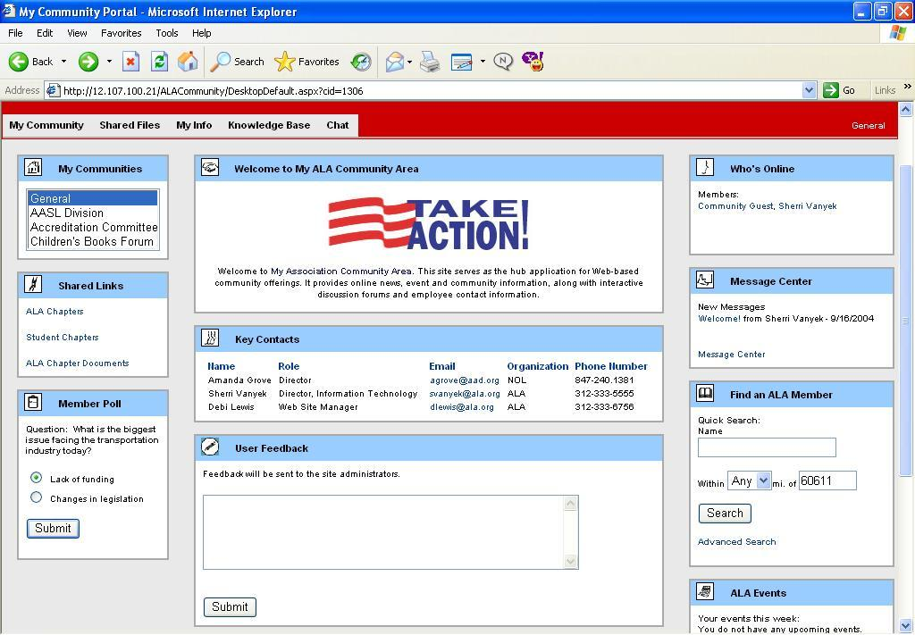
Welcome to My ALA!
Other Community members currently online
Message Center notifying member of new messages
Search function to find other Community members
Quick-glance of your scheduled events for the week

Slide 5
Welcome to My ALA!
Listing of your Communities
Shared Links for Members of the currently chosen Community
New Poll to be taken

Slide 6
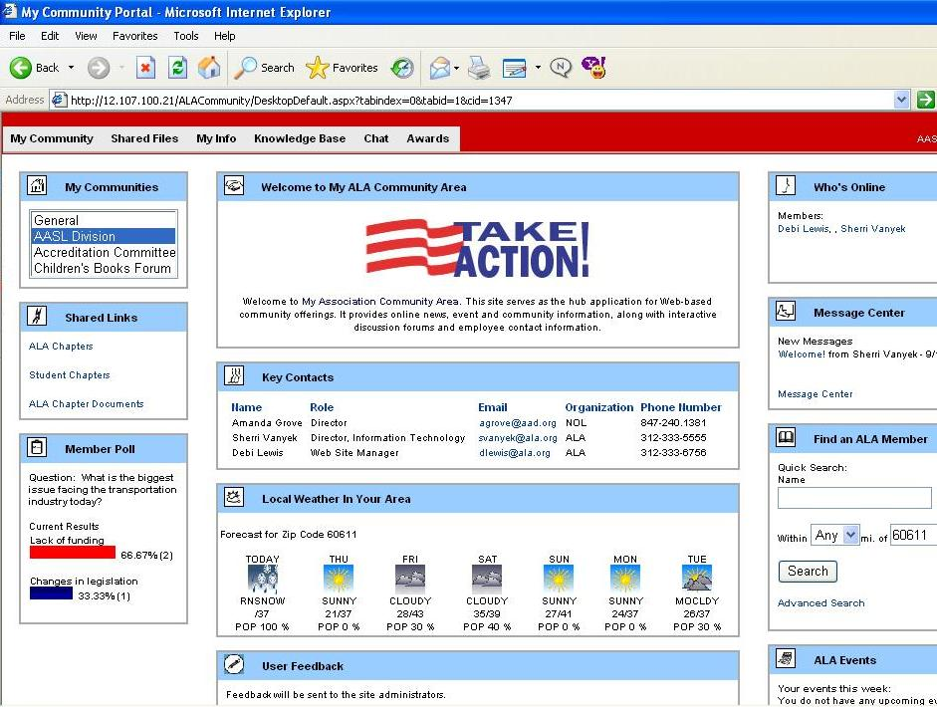
Home Page w/Weather
Weather for your area – keyed to your zip code set in “My Info”
Current results of poll

Slide 7
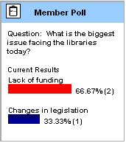
Survey Taken
Community administrators can create surveys with up to six possible responses.
Possible responses can be edited or added, totals reset, and polls reused at later dates if desired.

Slide 8
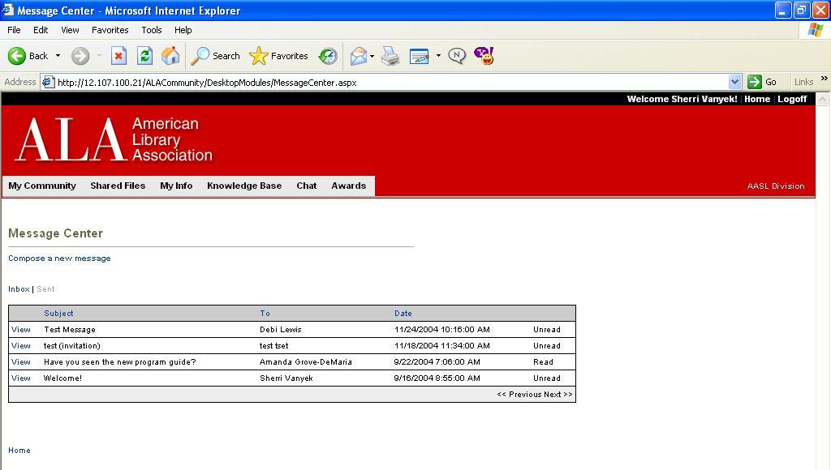
Message Center - Home
Unread Messages
The Message Center allows users to read, delete and compose new messages to other Community members.
New messages are flagged as “Unread” in the message center.

Slide 9
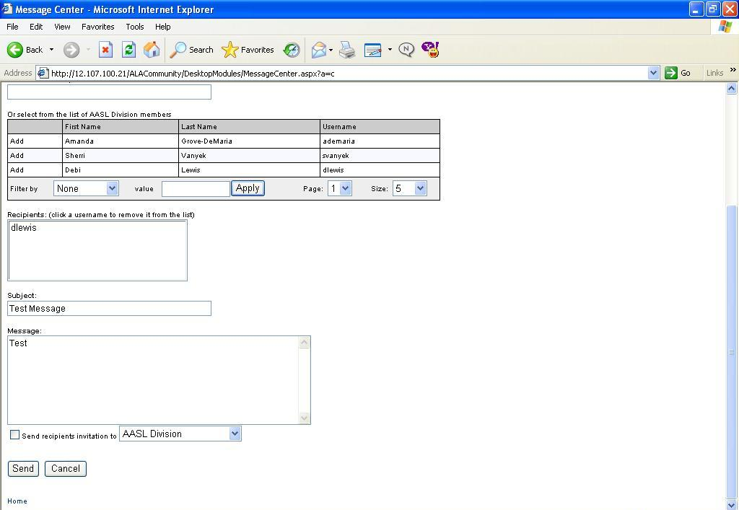
Message Center - Compose
When composing a message, users can select names from a list, then enter a subject and message to send.

Slide 10
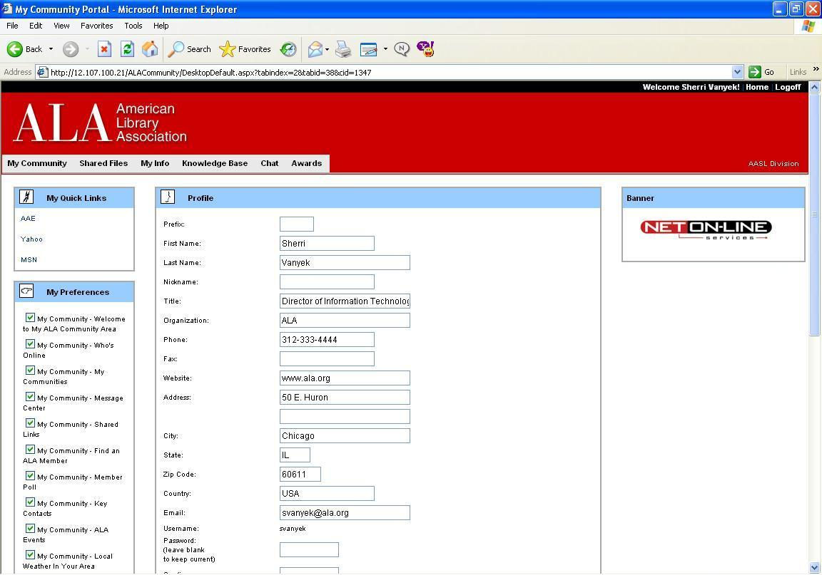
My Info
Personal information can be entered here as well as favorite links and choices for front page display options.

Slide 11
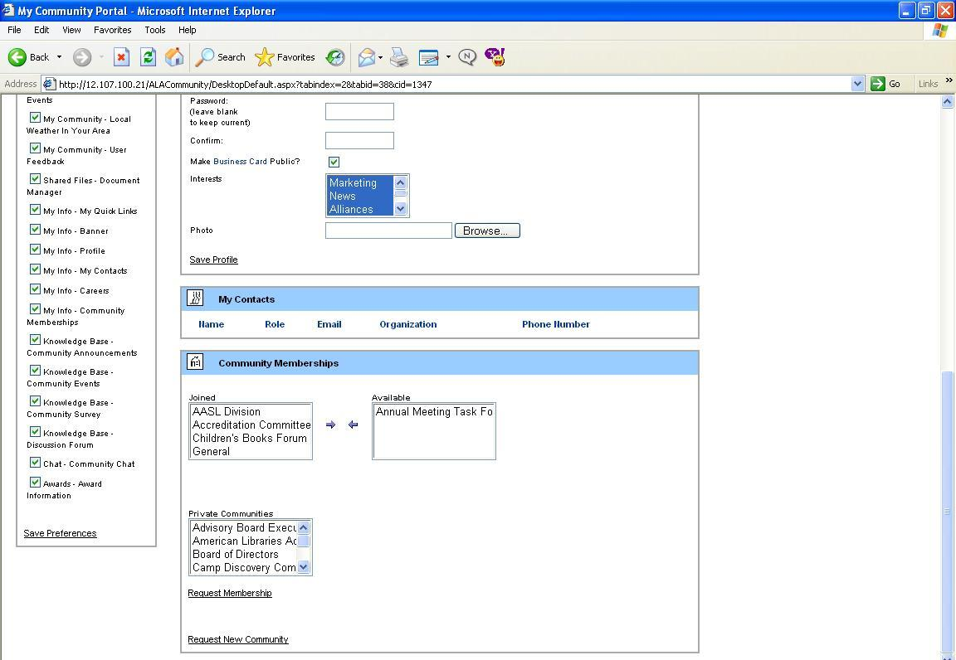
Add Community Memberships
Additional Communities can be added to your existing list.

Slide 12
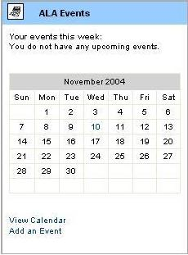
Your Calendar at-a-glance
Calendar dates with an event scheduled will appear in bold
The Calendar can be viewed by the month and Events can be added from this screen.

Slide 13
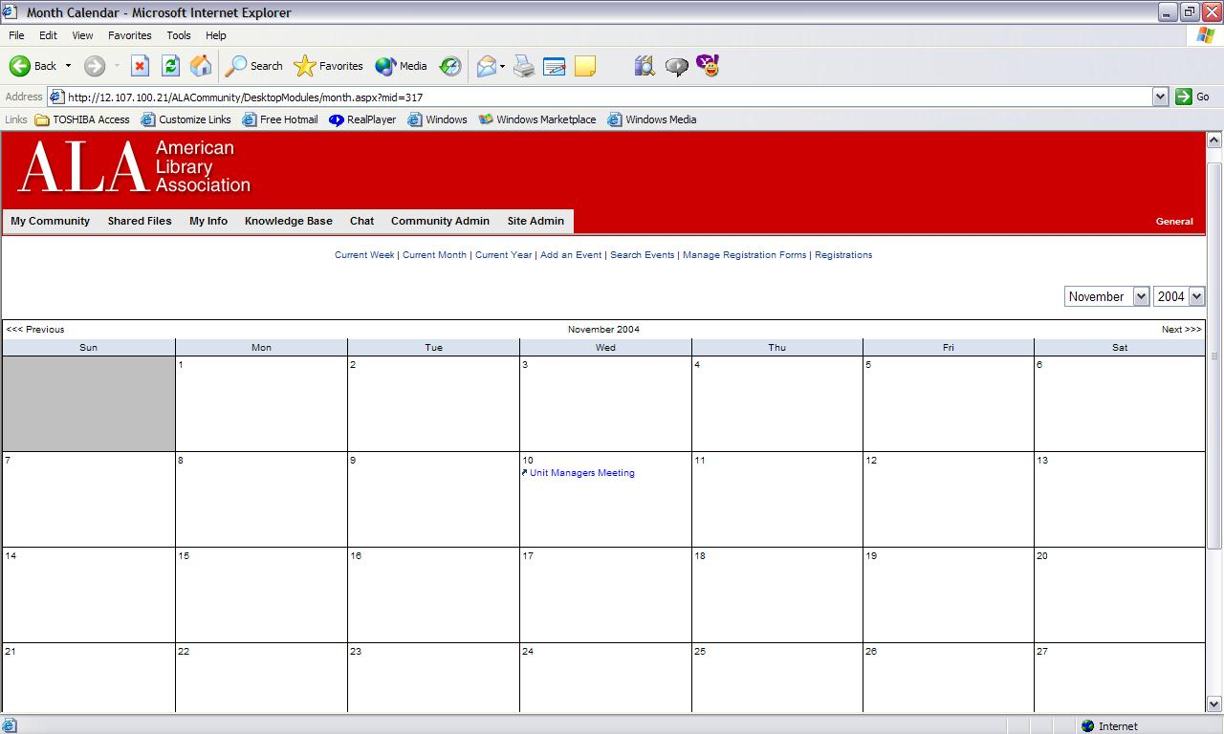
View your Calendar
Clicking on the text of an event will take you to the event details, including place and time

Slide 14
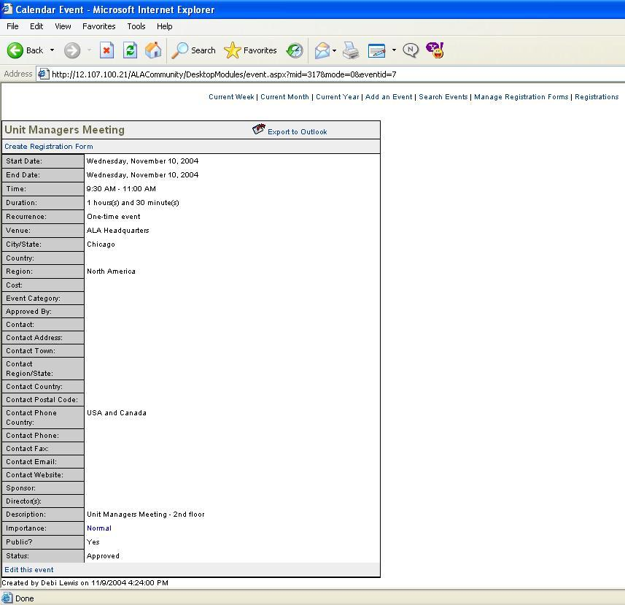
Show Events and Dates
Event details include the date, time and duration. Other details may be added by the scheduler such as location, contact information and a description of the event.

Slide 15
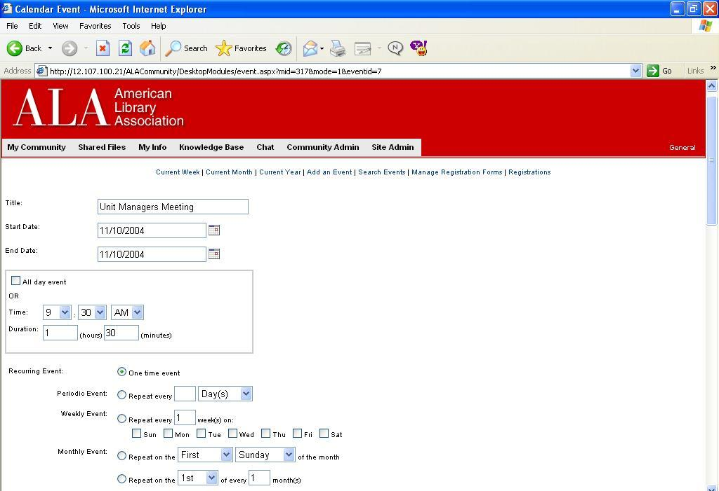
Create a new event
Events may be scheduled as either one-time events or repeating based on various criteria.

Slide 16
Options for working with shared files
View in an HTML browser
Lock or unlock during work
Download to user’s computer
Create new text files within the Online Community Editor
Edit text files within the Online Community Editor
Copy, move or delete selected files/directories

Slide 17
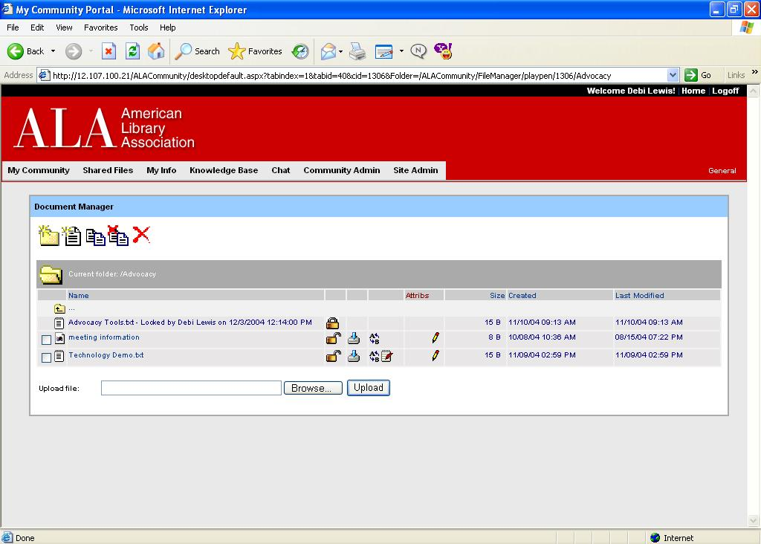
Shared Files
Share files among Community Members.
Documents may be saved within folders and subfolders for efficient access.
Files can be uploaded (e.g. .doc or .xls) or simple text files created within the Online Community editor.

Slide 18
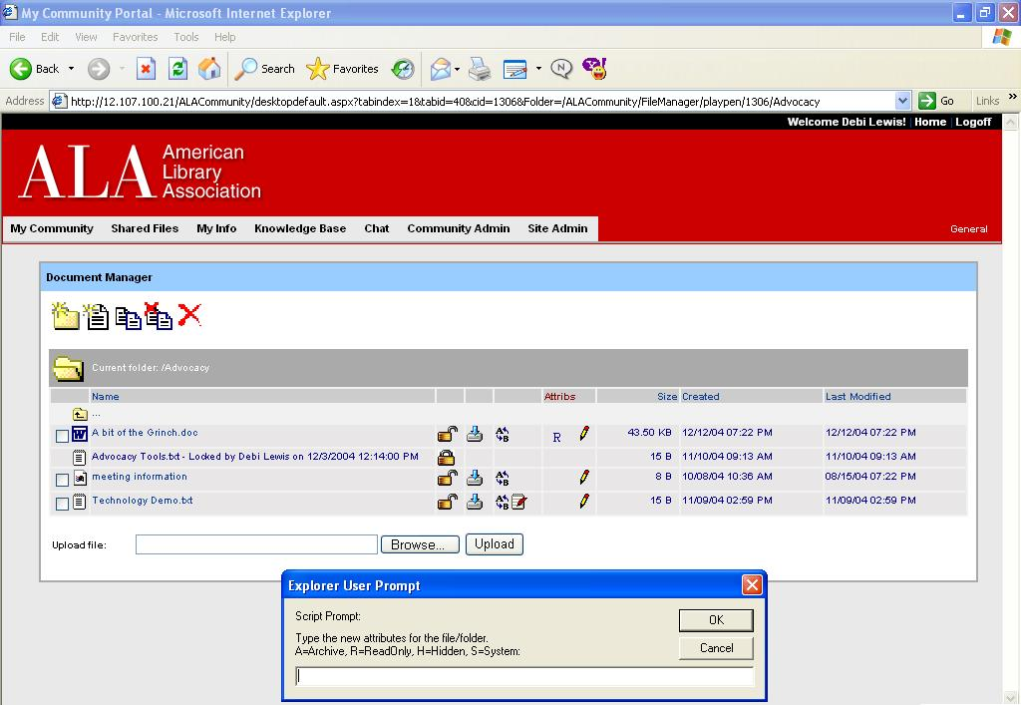
Directory Contents
Attributes can be set on individual documents, such as Archive, Read Only or Hidden.
Locked or Unlocked
Download to computer
Rename file
Existing file attributes
Edit file w/text editor
Edit file attributes

Slide 19
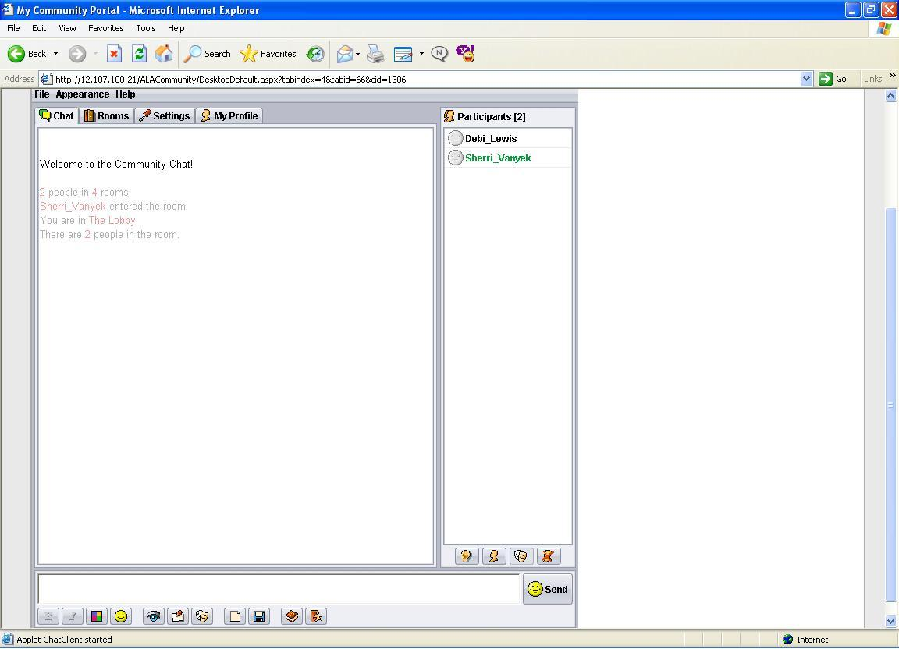
Chat Interface
The live chat interface allows logged-on members to speak to each other in real time
Options allow users to switch between chat rooms, edit their personal settings, and show their profiles to other members.

Slide 20

Get ready for ALA’s Online Communities
Threaded Discussions
File Sharing
Event Scheduling
Interactive Chat
Shared Links, Mail & More
ALA has answered the call for greater flexibility for members with Online Communities, full of enhanced features making it easier for our members to conduct the business of the Association.

Slide 21
Get ready for ALA’s Online Communities
Threaded Discussions
File Sharing
Event Scheduling
Interactive Chat
Shared Links, Mail & More
Watch for more announcements over the coming months as we prepare to launch the Online Communities site in the spring of 2005

Slide 22


Thank You!

